Slide 1
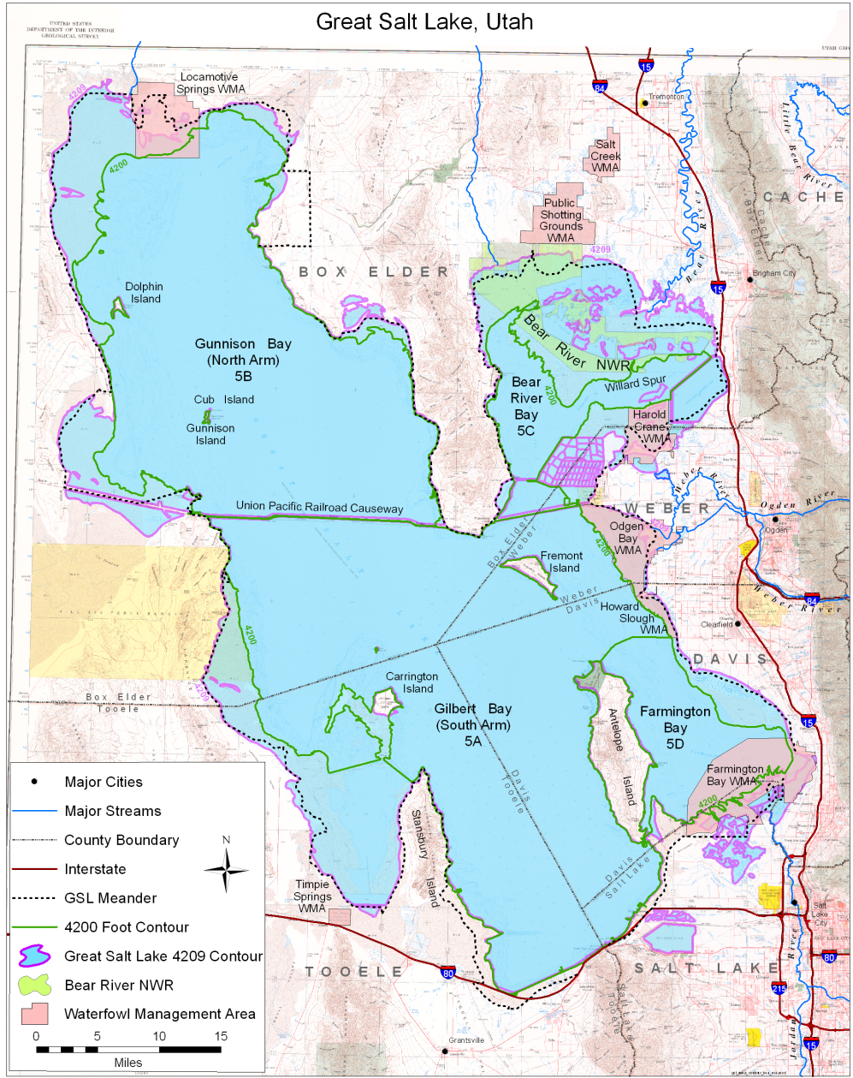
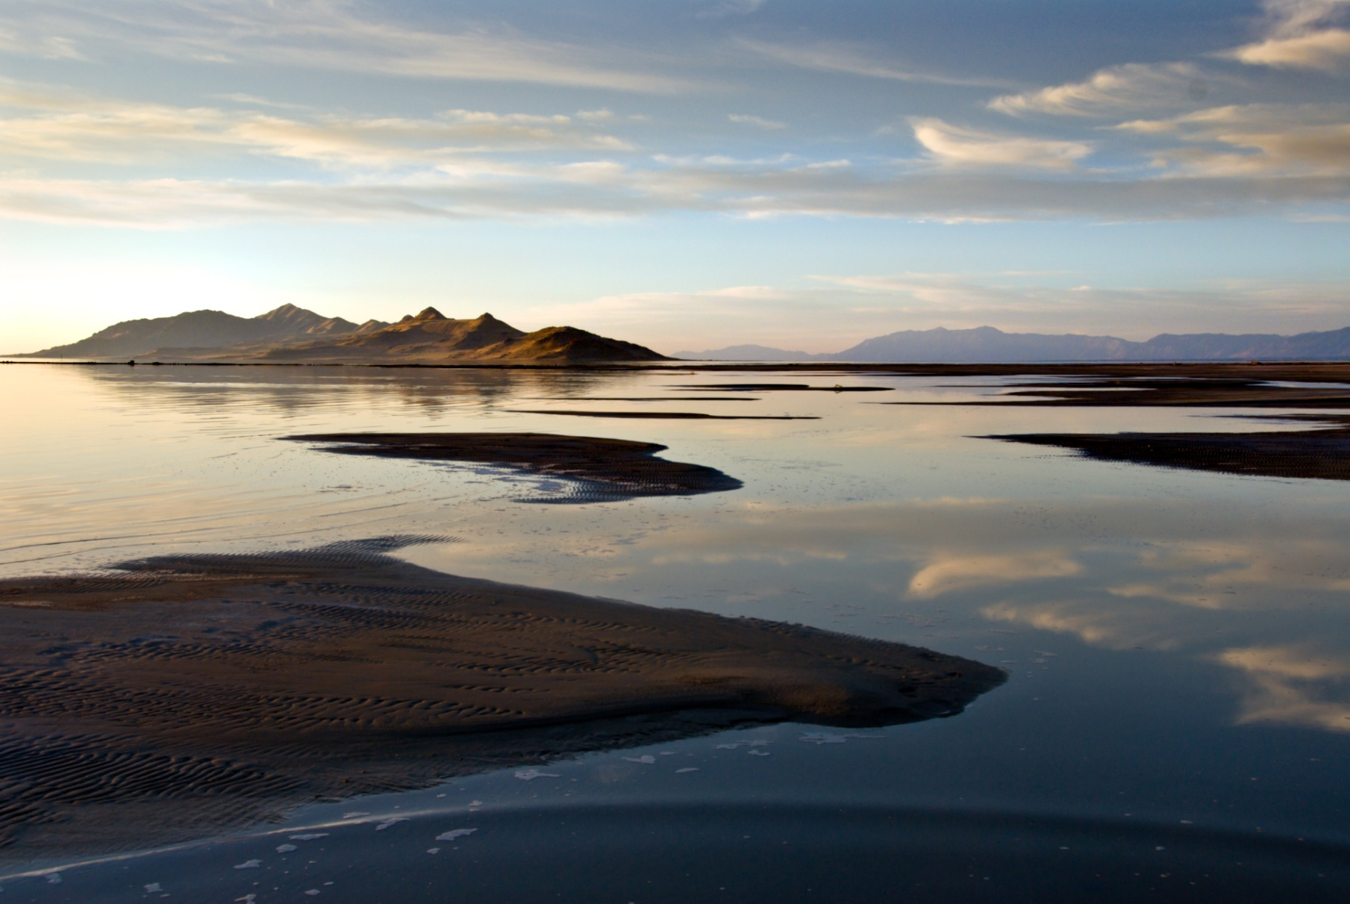
Great Salt Lake Water Quality Strategy
Utah Department of Environmental Quality/Division of Water Quality
UDWQ’s Vision
Great Salt Lake continues to provide its important recreational, ecological, and economic benefits for current and future generations.
Great Salt Lake (GSL) Facts:
4th largest terminal lake (no outlet) in the world
Remnant of Lake Bonneville—a prehistoric lake that was 10 times larger than the GSL
Average 75 miles long, 35 miles wide, and 14 feet deep
Primary sources of water are from precipitation and the Bear, Jordan, Ogden, and Weber Rivers
Salinity (“saltiness”) varies throughout the lake and ranges from freshwater to 7 times saltier than the ocean
Mostly fish free, the keystone species are brine shrimp and brine flies
Causeways divide the lake into four distinct bays (Gunnison, Gilbert, Bear River, and Farmington)
80% (360,000 acres) of Utah’s wetlands are adjacent to the lake
7 to 12 million birds, 250 species, visit the lake every year
$1.3 billion in total economic output to the State of Utah is generated by GSL industry, aquaculture and recreation.
Photo courtesy of Charles Uibel at greatsaltlakephotos.com
CONTACT
Figure 1. Great Salt Lake is a saline terminal lake located in Northern Utah. The primary sources of water to the lake are from precipitation and the Bear, Ogden, Weber, and Jordan Rivers. The lake spans across five county boundaries (Box Elder, Weber, Davis, Tooele, and Salt Lake). The Great Salt Lake meander line represents the boundary of sovereign lands managed by the Utah Division of Forestry, Fire, and State Lands. The historic (1847–1986) average elevation of the lake is 4,200 feet (United States Geological Survey, 2009). Utah Water Quality Act beneficial uses for Great Salt Lake (Classes 5A through 5E) extend to an elevation of 4,208 feet. Since this contour is not available spatially, the 4,209-foot contour is shown.
Jodi Gardberg, Great Salt Lake Watershed Coordinator
Utah Division of Water Quality
Email: jgardberg@utah.gov
Phone: (801) 536-4372
Website: www.waterquality.utah.gov/greatsaltlake

